Slide 1

Data Collection, Cleaning and EDA Project
Dhivya Kumar
Data Analysis Intern
Batch:332
ID:81020802024

Slide 2
Travel Triangle.com
Travel Triangle, is an online marketplace which empowers the travelers with customized holiday packages.
Problem Statement:
1) India tour packages by different guides analysis on different tourist spots
2) Tourist Guide Analysis

Slide 3
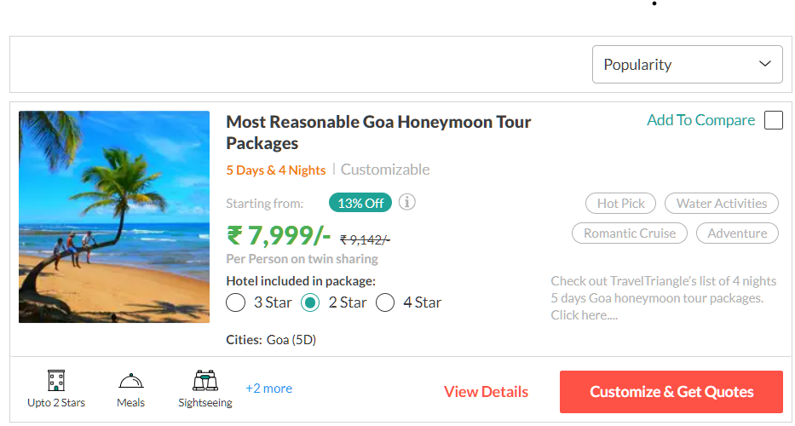
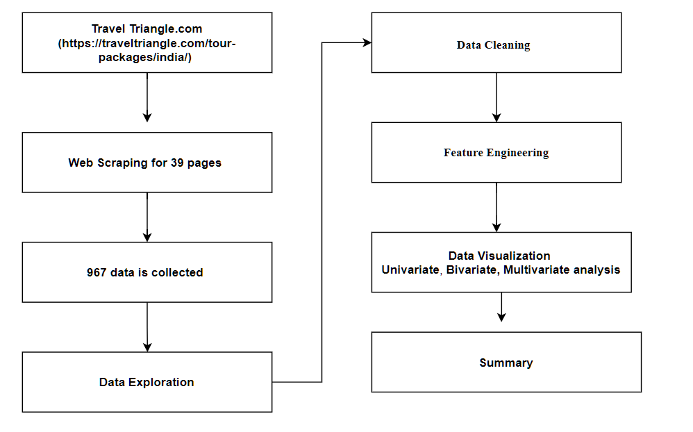
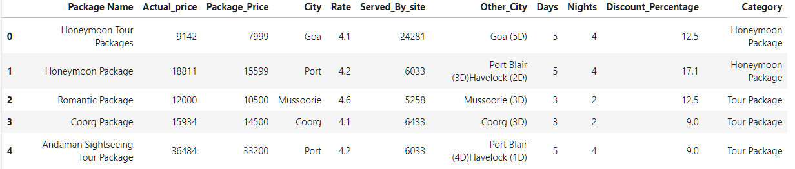
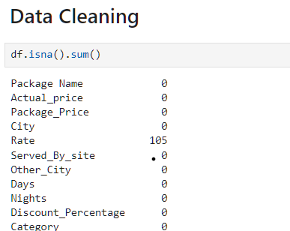
Pipeline of the Project

Slide 4
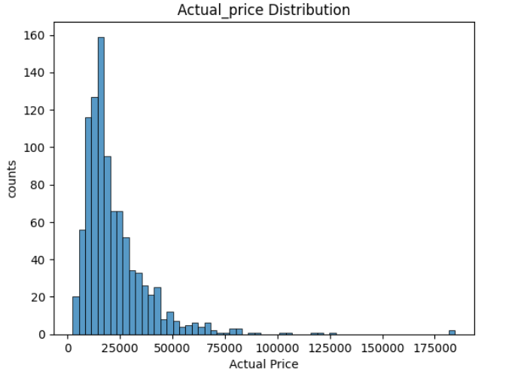
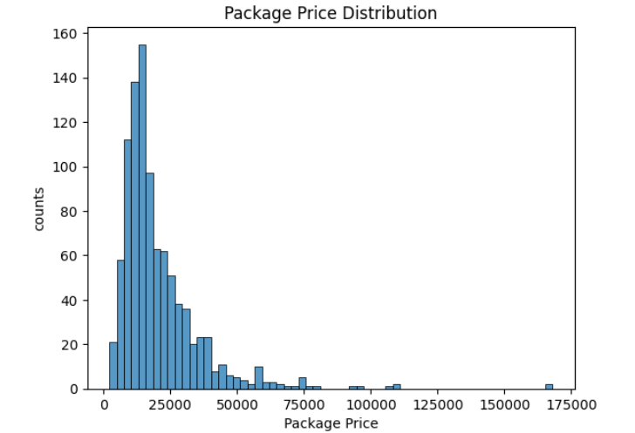
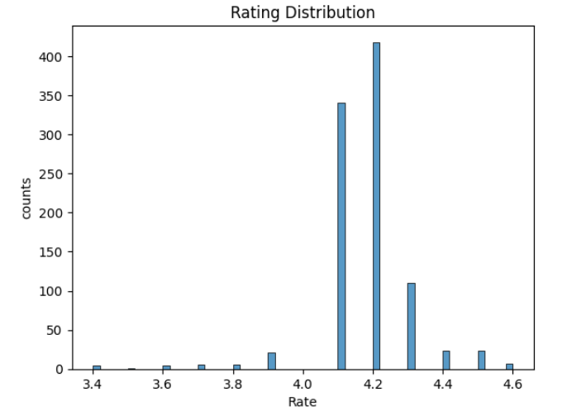
Univariate Analysis
Actual Price and Package Price are right-skewed, with most packages priced below ₹30,000. There are a few high-priced packages that are outliers.
On average, the Actual Price is ₹22,531, and the discounted Package Price is ₹20,431, showing a general markdown.
Ratings are clustered around 4.1 to 4.2, with a mean rating of 4.17. This indicates overall positive reviews for the packages

Slide 5
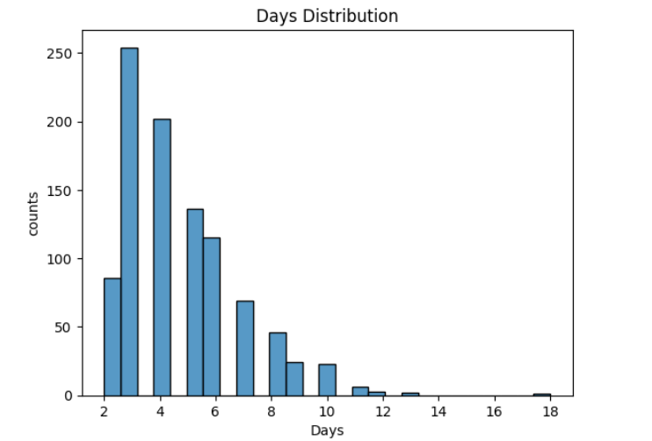
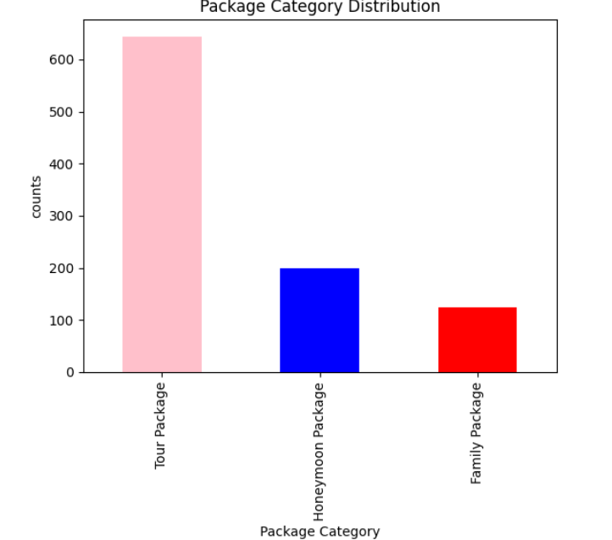
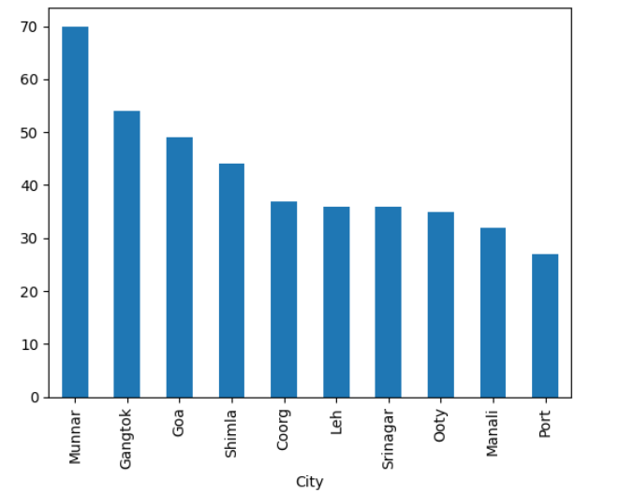
Cont..
Most packages have durations of 2 to 6 days (mean: 4.7 days) and corresponding nights between 2 and 5 nights (mean: 3.7 nights)
Tour Package is the most frequent category (644 occurrences), followed by Honeymoon Package.

Slide 6
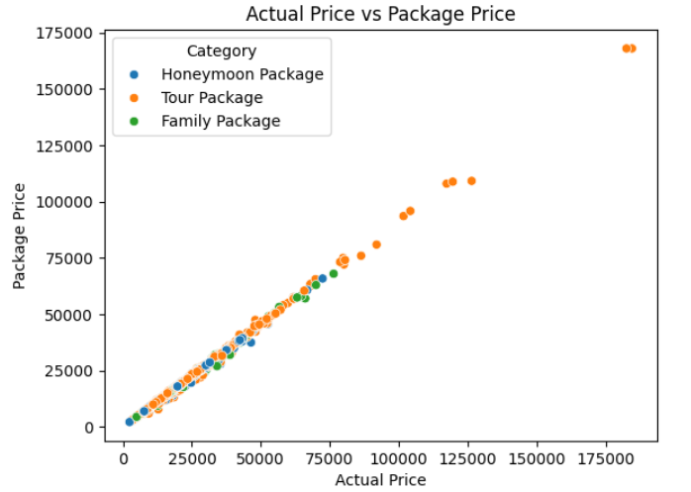
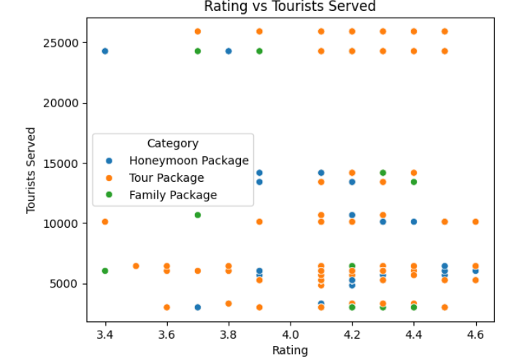
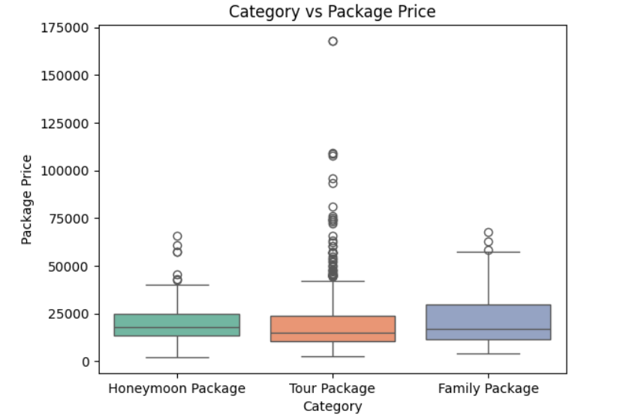
Bivariate Analysis
A strong linear correlation is observed between the Actual Price and Package Price.
Higher ratings are not necessarily linked to higher tourists served, suggesting that other factors (like price, location) might influence demand. Honeymoon Packages tend to serve more tourists at moderate ratings (around 4.2).
Honeymoon Packages generally have a slightly higher median price compared to Tour Packages. Tour Packages show more price variability, with a few outliers in high price ranges.

Slide 7
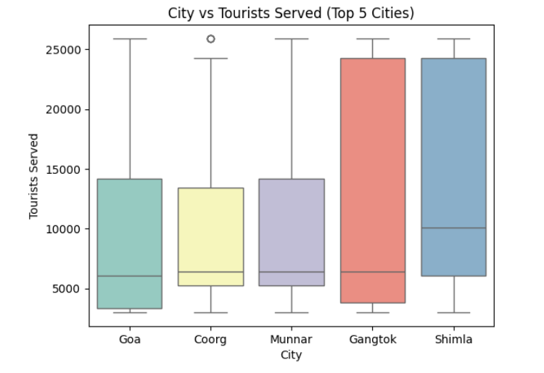
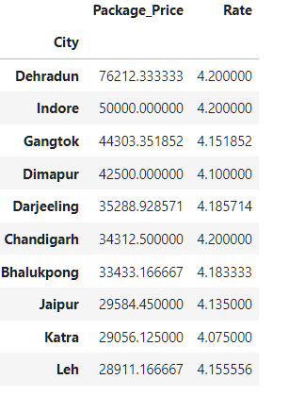
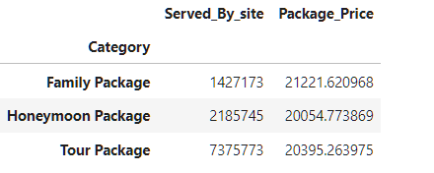
Cont..
Goa and Gangtok have a tourists, broader range of tourists served. Shimla consistently serves a higher number of indicating its popularity or guide availability.

Slide 8
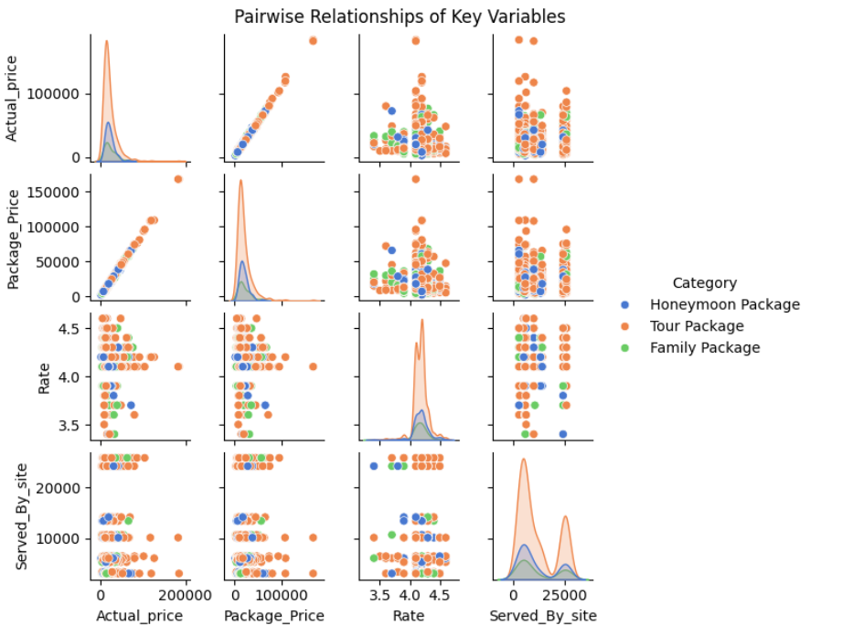
Multivariate Analysis
Pairwise Relationships
1. Actual Price vs. Package Price: Both show a strong positive correlation, indicating consistent discounting practices across categories. Honeymoon Packages often have slightly higher prices.
2. Rating vs. Served_By_site: While ratings (4.1–4.2) are generally consistent across packages, the number of tourists served varies, suggesting external factors like popularity of the city or duration matter more.

Slide 9
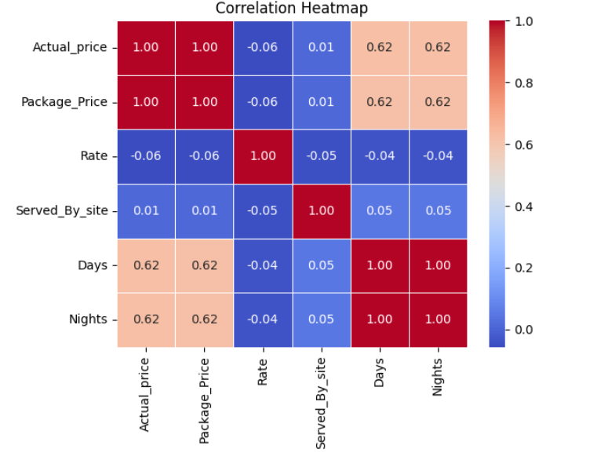
Cont..
1.Days and Nights are perfectly correlated (1.0), as expected.
2.A strong correlation between Package Price and Actual Price (~0.98).
3.Served_By_site has a weak positive correlation with Rate and Days, meaning longer, highly-rated packages slightly attract more tourists.

Slide 10
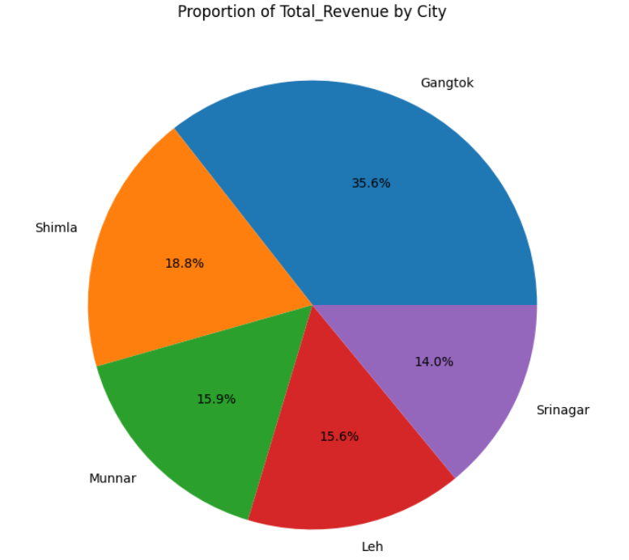
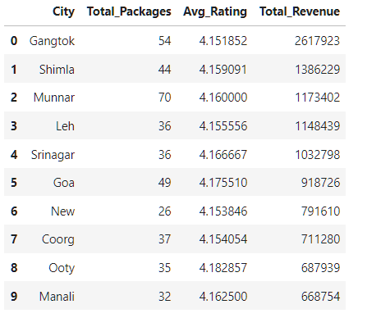
Problem Statement
1. India Tour Packages Analysis
Top 5 Packages based on the City with respective total revenue: Gangtok served by 35.6% of revenue, followed by Shimla by 18.8%, Munnar by 15.9%, and Leh served by 15.5%

Slide 11
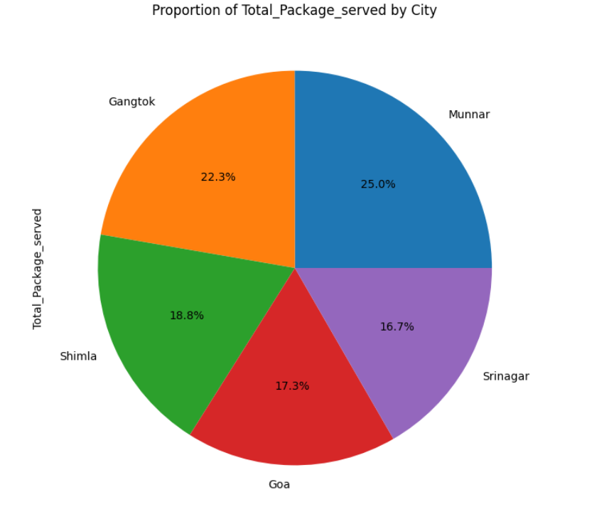
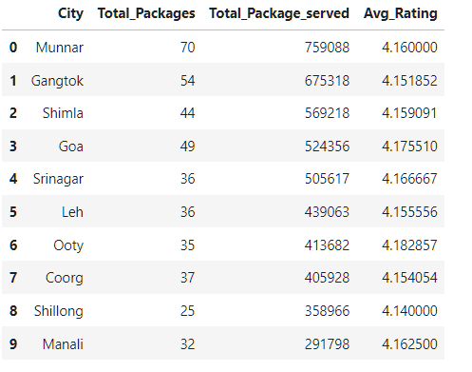
Cont..
2. Tourist Guide Analysis
Top 5 city is which has highest number of TravelTriangle has served packages Munnar as served 25%, followed by Gangtok as 22.3%, Shimla as served 18.8%, Goa served 17.3% and Srinagar served by 16.7%

Slide 12
Conclusion
Package Duration:
Packages with 4–6 days perform better in terms of tourists served. Extending durations in popular locations could increase demand.
Tourists Served by Cities:
Cities like Goa and Shimla consistently serve a higher number of tourists, indicating their strong draw. Marketing efforts should focus on these cities.
Category-Specific Preferences:
Honeymoon Packages tend to have higher prices but serve more tourists, implying couples' preference for premium services. Tour Packages have greater variability in prices, with some high-priced options not performing as well.
Ratings and Popularity:
High ratings (above 4.2) correlate weakly with tourists served, suggesting practical factors like price and destination matter more than customer reviews alone.
Problem Statement 1. India tour packages by different guides analysis on different tourist spots
Top 5 Packages based on the City with respective total revenue: Gangtok served by 35.6% of revenue, followed by Shimla by 18.8%, Munnar by 15.9%, and Leh served by 15.5% 2. Tourist Guide Analysis
Top 5 city is which has highest number of Travel Triangle has served packages Munnar as served 25%, followed by Gangtok as 22.3%, Shimla as served 18.8%, Goa served 17.3% and Srinagar served by 16.7%
Suggestions 1. Customers tend to prefer discounted packages, which is evident in the proportionality between Actual Price and Package Price. 2. Higher-priced packages attract fewer customers unless they are in highly demanded destinations.

Slide 13


